Slide 1

AIR quality index
Pollution Across North America

Slide 2
Agenda
Real-Time Air Quality and Heat Map
City-wise Air Quality Comparison
Time-based Air Quality Trends
Glossary of Terms
Notable Libraries Used
In Conclusion
Ethical Considerations

Slide 3
Glossary of Terms
AQI – Air Quality Index
1 = Good
2 = Fair
3 = Moderate
4 = Poor
5 = Very Poor
Concentration of Pollutants - μg/m3
CO (Carbon monoxide)
NO (Nitrogen monoxide)
O3 (Ozone)
SO2 (Sulphur dioxide)
PM2.5 (Fine particles matter)
PM10 (Coarse particles matter)
NH3 (Ammonia)

Slide 4



Notable Libraries Used
Notes:
Folium – used for generation of heat map
Plotly – used in generation of interactive bar chart
Panel -

Slide 5

Real-Time Air Quality and Heat MAp

Slide 6
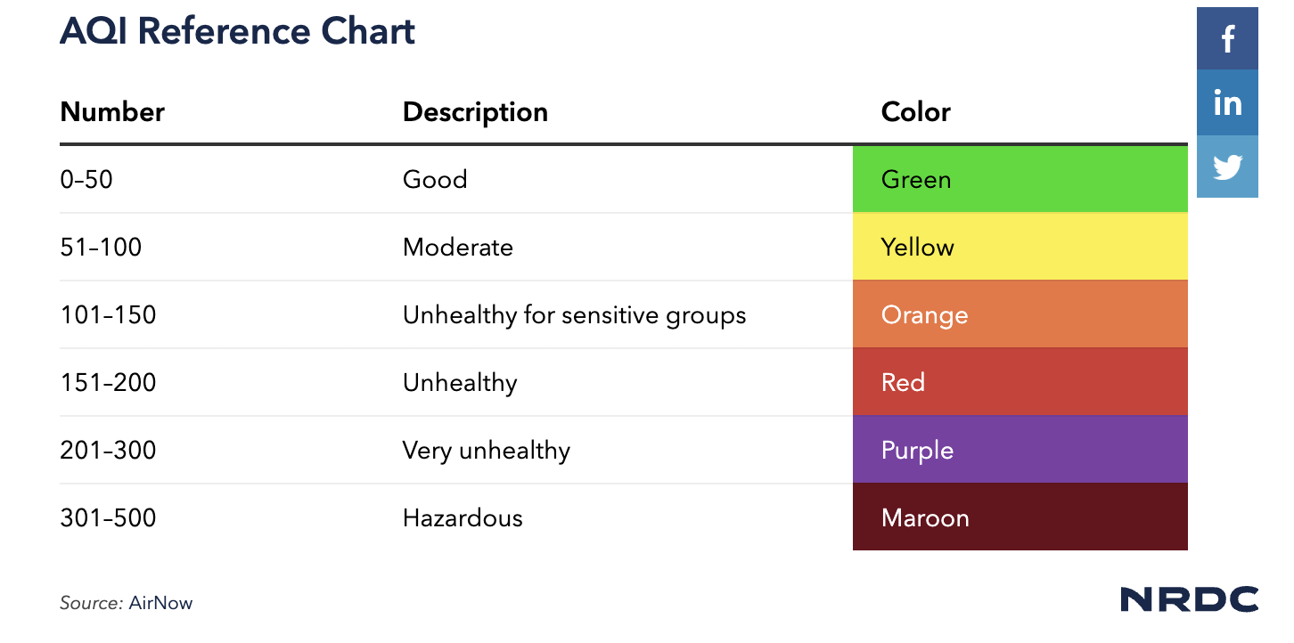
Air Quality Concentration Guide
The two most common air pollutants in North America are O3 and PM2.5 and PM10.
AQI changes daily depending on weather and environmental conditions

Slide 7
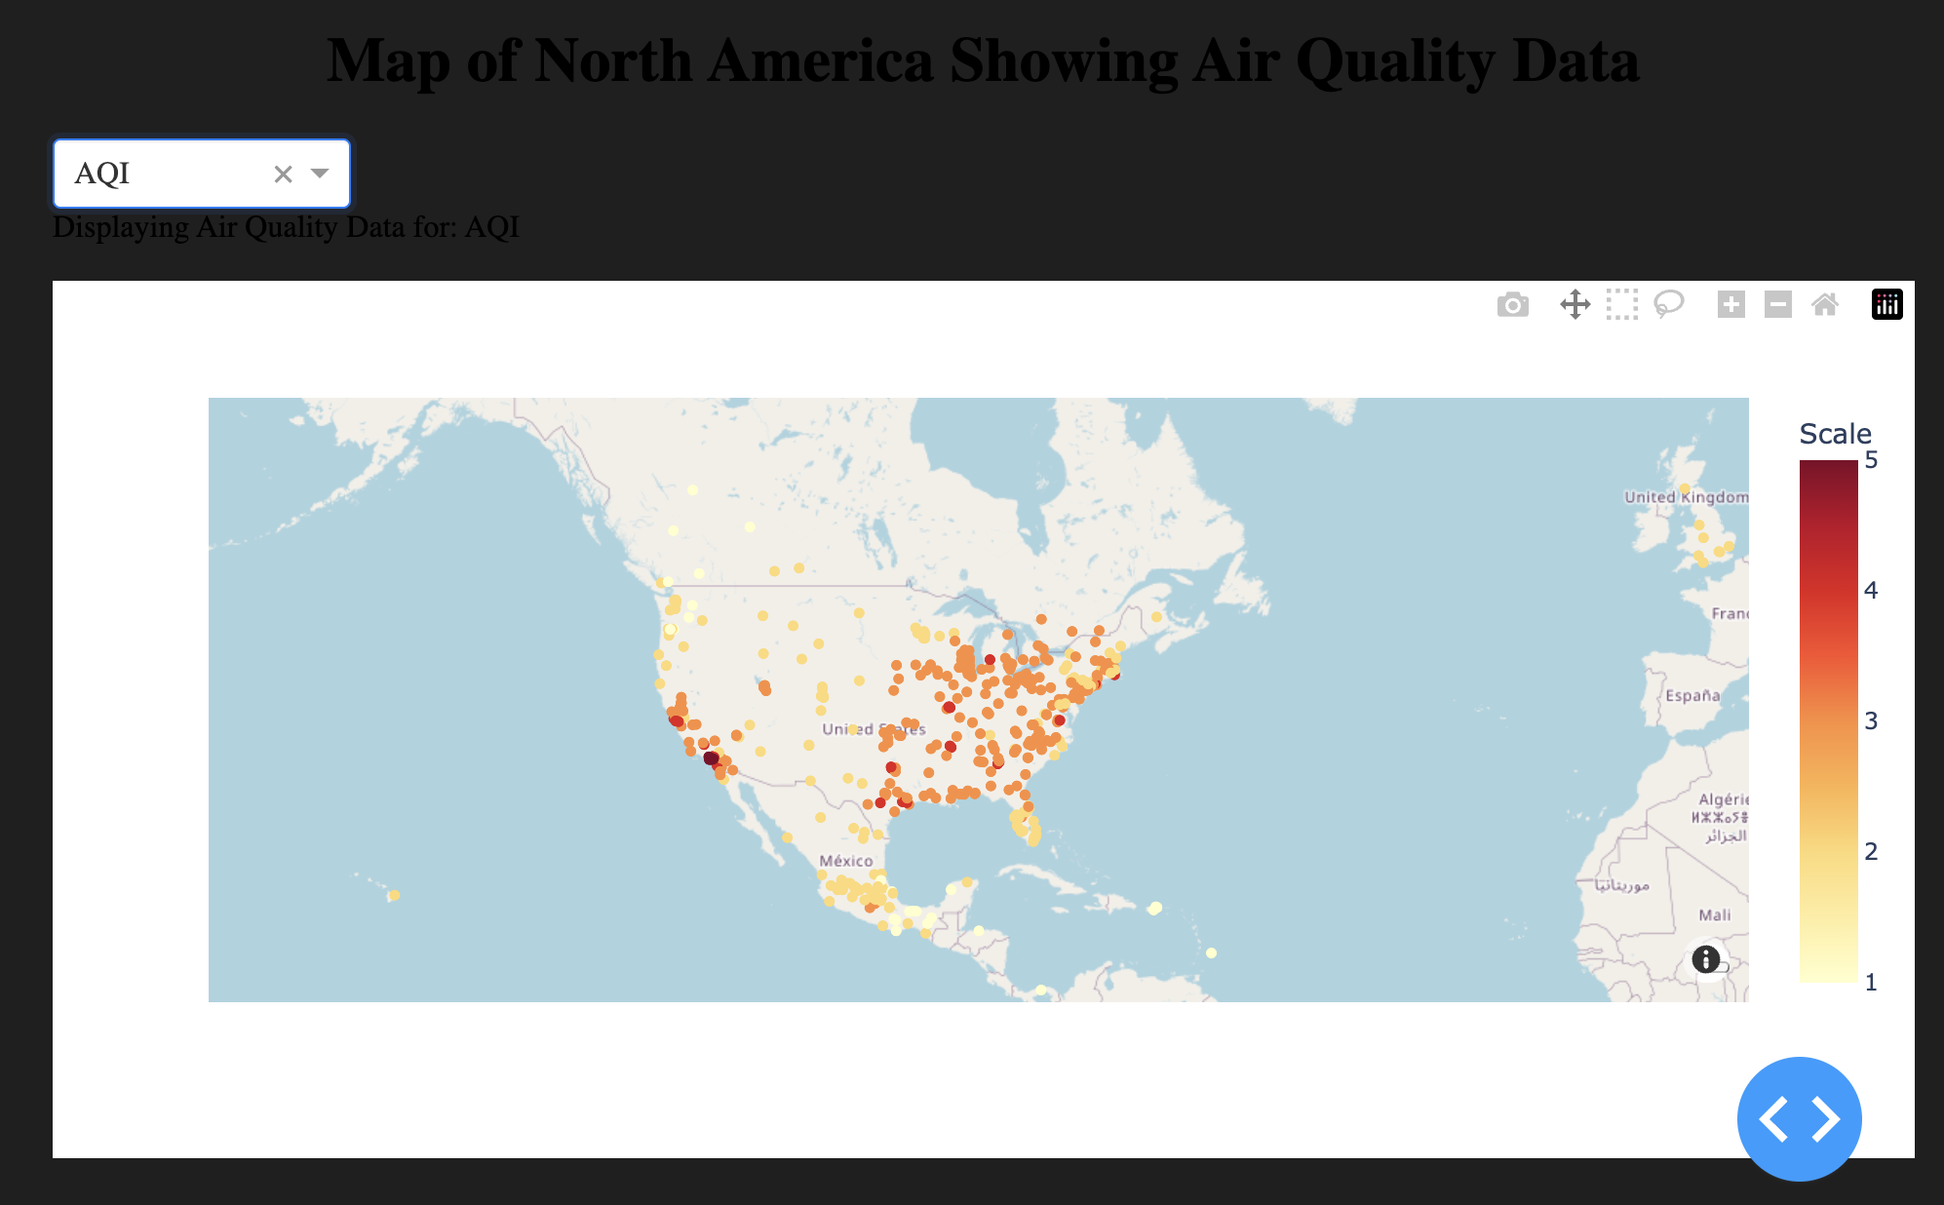
Real-Time Air Quality Map for AQI as of Oct 20, 2024
AQI was primarily bad across the USA with a Value higher than 3-5
Mexico and Canada showed to have good Air Quality ranging from 1-2

Slide 8
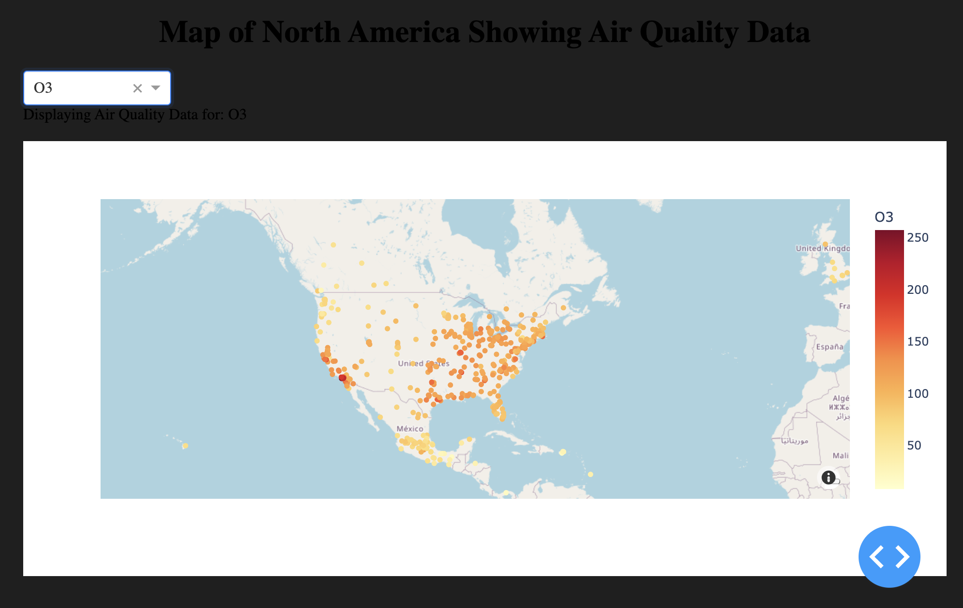
Real-Time Air Quality Map for O3 as of Oct 20, 2024
Ozone is formed in the atmosphere through chemical reactions between
Pollutants emitted into the air
Oct 20, showed a high concentration of O3 across most of USA
Mexico showed a lower concentration

Slide 9
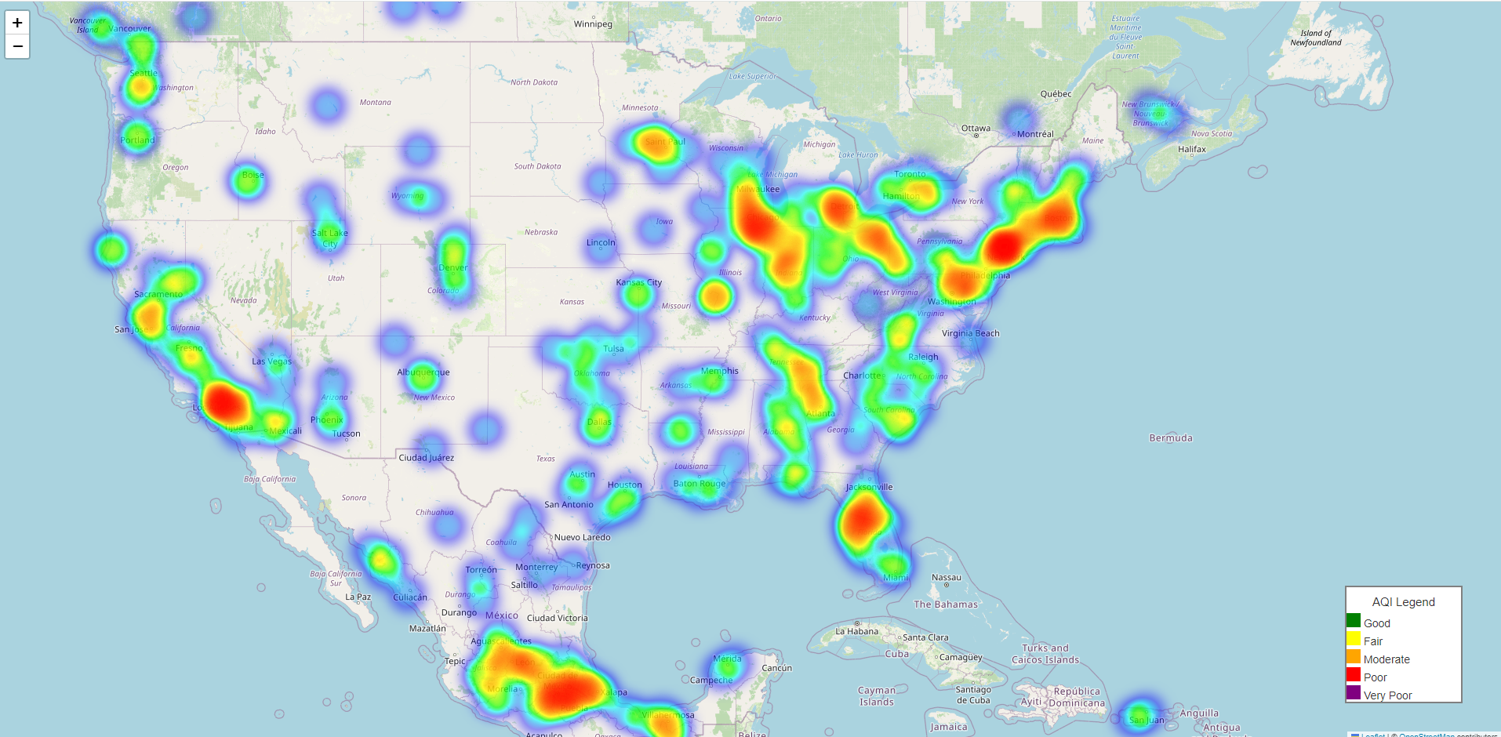
Heat Map

Slide 10

City-wise Air Quality Comparison
Notes:
We compared the 5 cities with the best air quality and the 5 cities with the worst air quality, focusing on two main parameters: PM2.5 and AQI

Slide 11
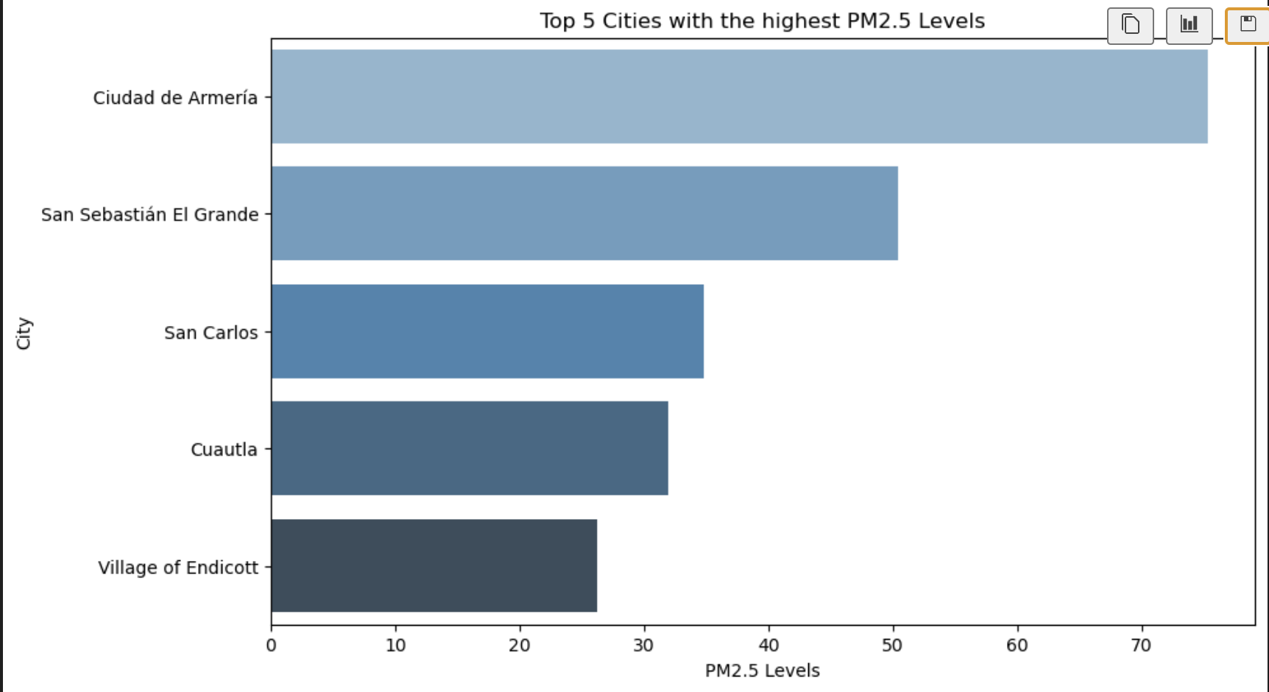
Top 5 Cities with the highest PM2.5 Levels
PM2.5 refers to fine particles 2.5 micrometers or smaller that can penetrate the lungs and cause health risks.
The bar chart shows the top 5 cities with the highest PM2.5 levels, indicating severe air pollution.
Most of these cities are in Mexico, highlighting significant pollution issues in the region.
Notes:
PM2.5 refers to fine particulate matter with a diameter of 2.5 micrometers or smaller, that pose serious health risks by penetrating deep into the lungs and bloodstream.
The bar chart illustrates the top 5 cities with the highest PM2.5 levels, indicating cities suffering from dangerous air pollution levels.
These cities are predominantly located in Mexico, indicating areas with considerable air pollution concerns within the region.

Slide 12
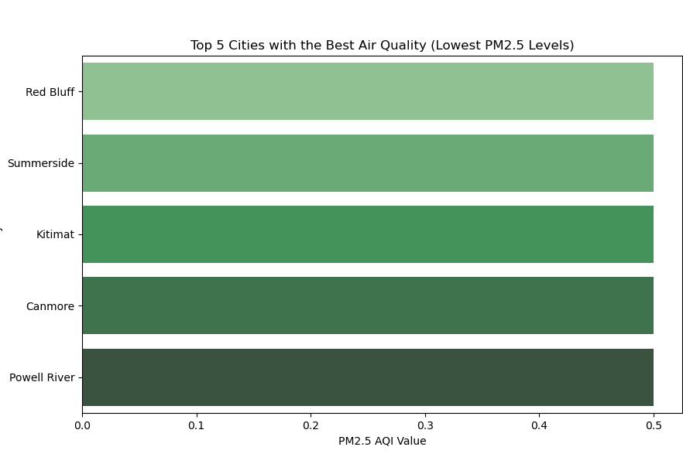
Top 5 Cities with the lowest PM2.5 Levels
The cities shown in this visualization are located in The United States and Canada, with all of them exhibiting low PM2.5 levels, indicating excellent air quality.
Canada, in particular, has several cities with very clean air, likely due to lower levels of industrial pollution and a focus on environmental sustainability.
Notes:
The cities shown in this visualization are located in The United States and Canada, with all of them exhibiting low PM2.5 levels, indicating excellent air quality. Canada, in particular, has several cities with very clean air, likely due to lower levels of industrial pollution and a focus on environmental sustainability.

Slide 13
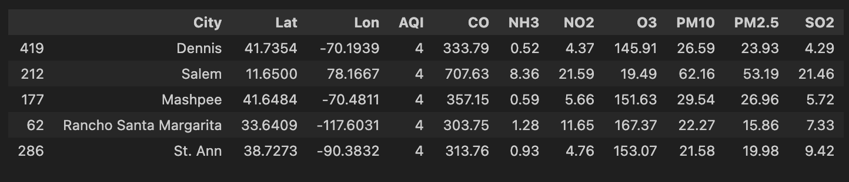
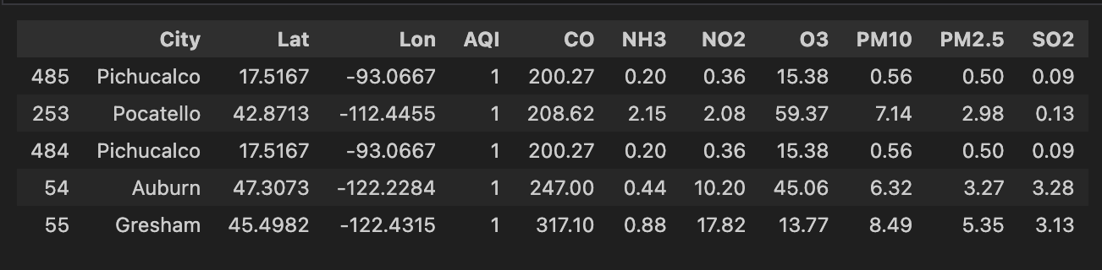
Top 5 Cities with the highest/lowest AQI Levels
Top 5 Cities with the Highest AQI Levels
The Air Quality Index (AQI) reflects the combined impact of multiple pollutants, and cities with higher levels of pollutants like PM2.5, PM10, NO2, and CO typically have higher AQI values.
Top 5 Cities with the Lowest AQI Levels​
Notes:
The Air Quality Index (AQI) is designed to reflect the aggregate effect of multiple pollutants, and as expected, cities with higher concentrations of pollutants like PM2.5, PM10, NO2, and CO tend to have higher AQI values.
Cities with the highest AQI, such as Dennis and Salem, USA, show elevated levels of pollutants like PM10 and NO2, indicating significant pollution.
In contrast, cities with the AQI value of 1, like Pichucalco, Mexico and Gresham, USA, have much lower pollutant levels, reflecting cleaner air and better overall air quality.

Slide 14

Time-based Air Quality Trends

Slide 15
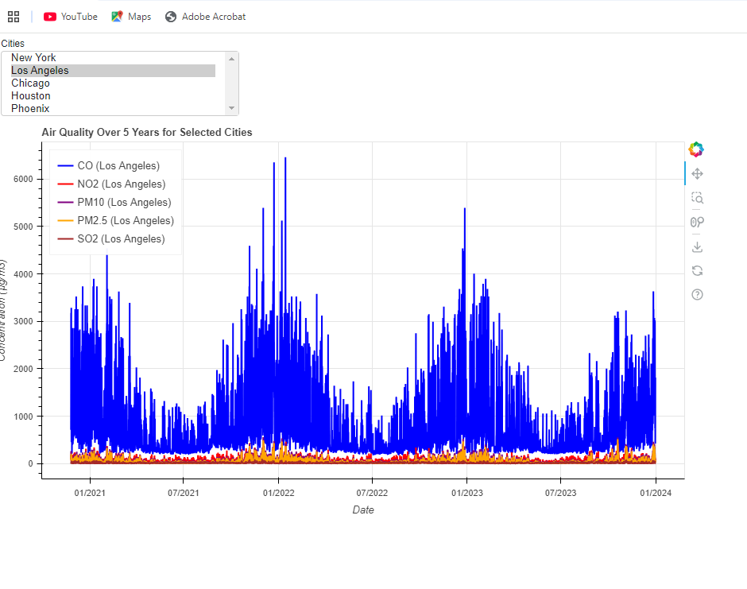
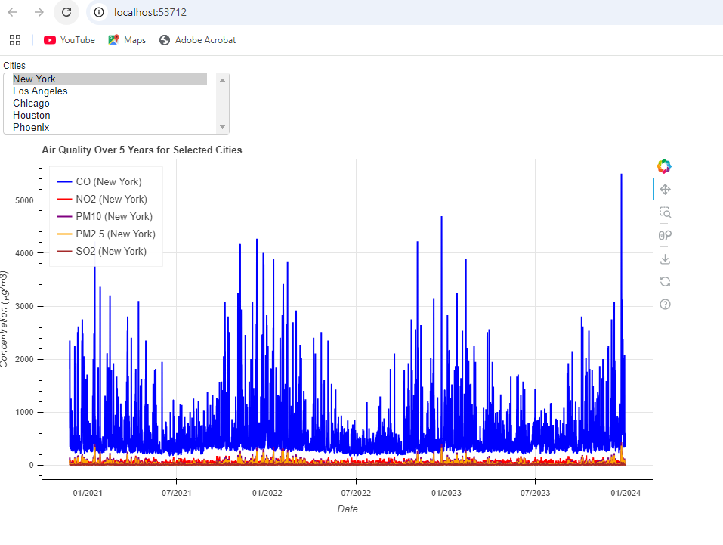
Time-based Air Quality Trends
Highest CO level
Los Angeles experienced the highest spike in CO levels in 2022, surpassing 6,000, leading to elevated AQI values and contributing to it being one of the most polluted cities.
New York saw its highest CO spike in 2024, exceeding 5,000, similarly resulting in a high AQI and placing it among the most polluted cities.

Slide 16

In Conclusion

Slide 17
In Conclusion
We see higher than average Air quality index in cities like Los Angeles and Texas that have high rates of industrialization and consumption of fossil fuels
Data on Air quality is updated daily. The values discussed in this presentation as "real-time" refer to a snapshot taken on October 20, 2024.
We found that CO, O3 and count of particulate matter are the pollutants most likely to contribute to the Air quality index in North America
Dataset limited to 500 cities in North America to stay within free API limits

Slide 18

Ethical Considerations

Slide 19
Ethical considerations
We used the OpenWeather map's air quality API for analysis.
Based on existing policies, our assumption is that in sourcing the data for the air quality dataset, the following principles were adhered to:
respect for individual privacy
accuracy in data collection
transparency in processes
adherence to lawful practices

